Slide 1
Mission Driven Publishing in the 21st Century
Charleston Library Conference

Slide 2
Panelists
Niko Pfund – Oxford University Press
@OxUniPress
Chris Bennett – Cambridge University Press
@cambridgelib
Elizabeth Windsor – John Hopkins University Press / Project MUSE
@JHUPress
John Sherer – University of North Carolina Press
@jesherer

Slide 3

Issues and Challenges
of Mission
Driven Publishing

Slide 4
Publishing is DOOMED!
Consider
Print sales down 2-3% in 2016
Library budgets flat
Retail bookstores struggling
Old-school, musty industry that can’t keep up
Amazon devouring our world?
Attention competition from other media (serial dramas, social media, any-time media consumption via mobile)
Recent history of other media (journalism, music industry in turmoil)
DISINTERMEDIATION is upon us

Slide 5
Or maybe not?
eBooks and Print-on-Demand Driving Efficiency
“Long Tail” Effect Offers Benefit to Publishers
Publishers Not Reliant on Advertising
Unlike Music, Books Aren’t “Disaggregatable”
Book Format More Durable Than Expected
Digital Revolution Already Well Underway
Author & Editor/Publisher Bond is Unchanged….
….especially at University Presses
Print Sales UP in 2015** and 2017
**adult coloring book effect

Slide 6
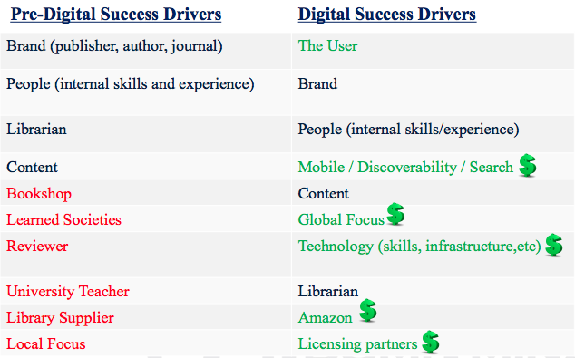
What drives publishing success?

Slide 7

The In-Between Years
“We tend to overestimate
the effect of a technology in
the short run and underestimate
the effect in the long run.”
Roy Amara (1970s)
The Institute for the Future

Slide 8
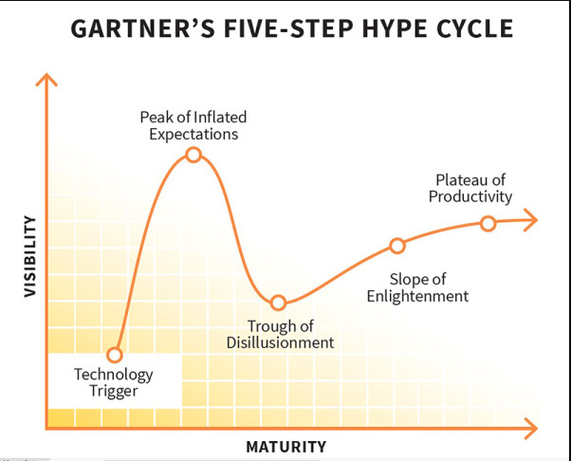
Gartner’s Hype Curve

Slide 9

What to make of this sentiment?
“We no longer have to depend on
so-called or self appointed
experts to tell us what we
should think.”
--Markos Moulitsas Zuňiga
Founder of Daily Kos

Slide 10

Open Access: mission enabler or disruptor?

Slide 11
Drivers
Mandates
Changes to research assessment metrics
Discoverability and accessibility of research; public engagement
Reproducibility and rework
Digital developments
More researcher collaboration

Slide 12
OA has come a long way…
EU2020
UK SCL

Slide 13
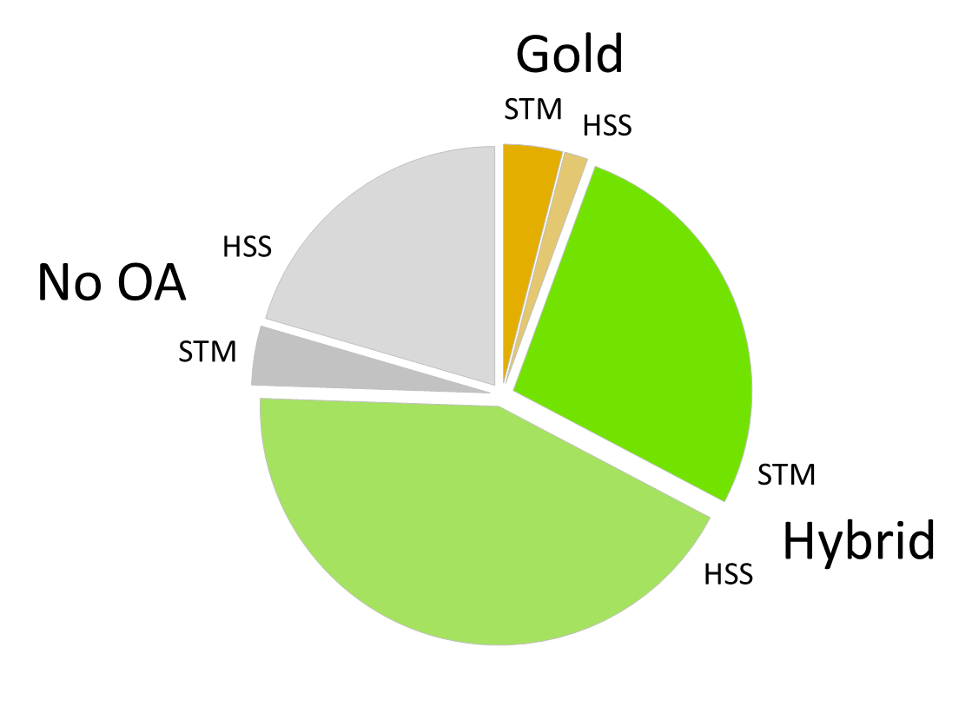
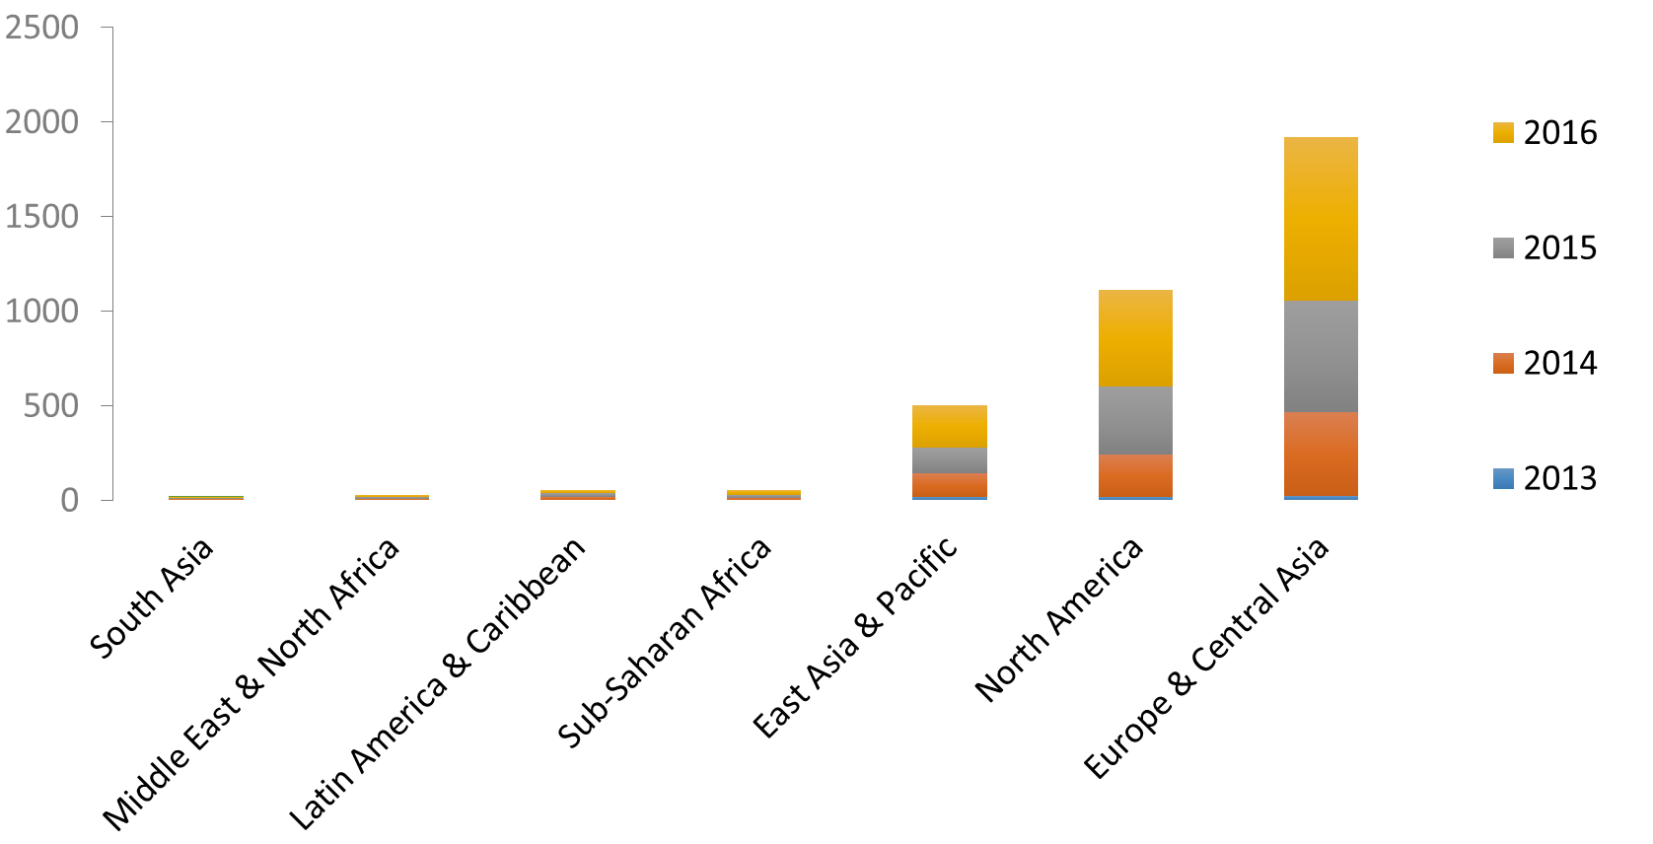
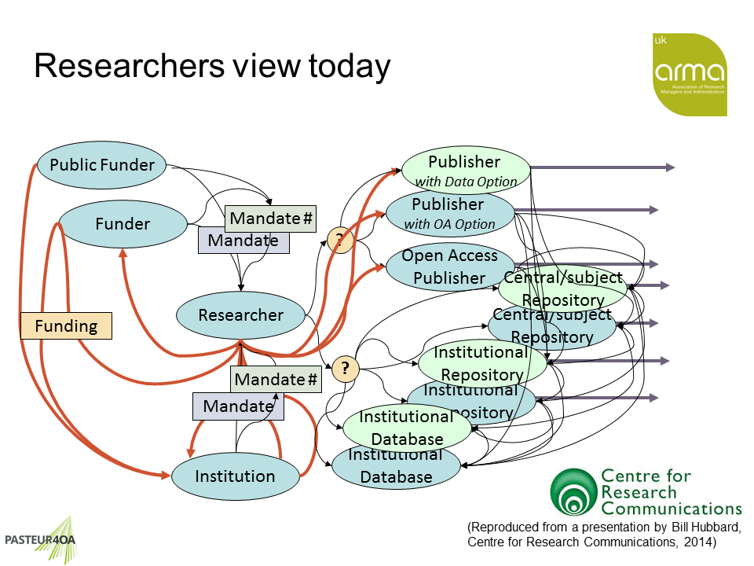



…but is it a sharing world?
Political developments in conflict with OA principles
Competitive advantage of research outcomes overlooked?
Uneven policies and their application by region
No developed, consistent or sustainable economic model
Funding drives OA uptake and support: variance by subject
OA publishing infrastructure limited
Is journals publishing doomed?

Slide 14























Disruption (and excitement!)
Finding information about funding
Discovering new research
Recording research
Managing/storing data
Collaborating with colleagues
Generating/ measuring impact
Identifiers
Peer review
Depositing research/Pre-print servers

Slide 15
Mission-driven OA publishing @ Cambridge
Placing researcher need at the heart of what we do…
Create a simple, effective OA workflow
Allow the manuscript to be fully open
Progressive archiving and sharing policies
Experimentation with open peer review, tools for social sharing
Maximise discovery: metadata enhancements, interlinking of scholarly content
Openness beyond the content: joining initiatives like I4OC to distribute our reference citation data openly

Slide 16
Mission-driven OA publishing @ Cambridge
…and funding it!
Value proposition: Paying for content > Paying for access > Paying for service
Flip the model: at title level or via conversion of collection sales
No “double-dipping”
Diversification: author services, OERs and course development
Partnerships: participation in Knowledge Unlatched, AAUP OA Monographs etc.

Slide 17

Data, Analytics and their relationship with publishing

Slide 18
Predictive Model
Goal: Identify the titles that will sell in the new sales model
Data used for the model:
Publisher attributes: size (title output), participation with other digital aggregators
Title attributes: research area, age of title, digital list price

Slide 19

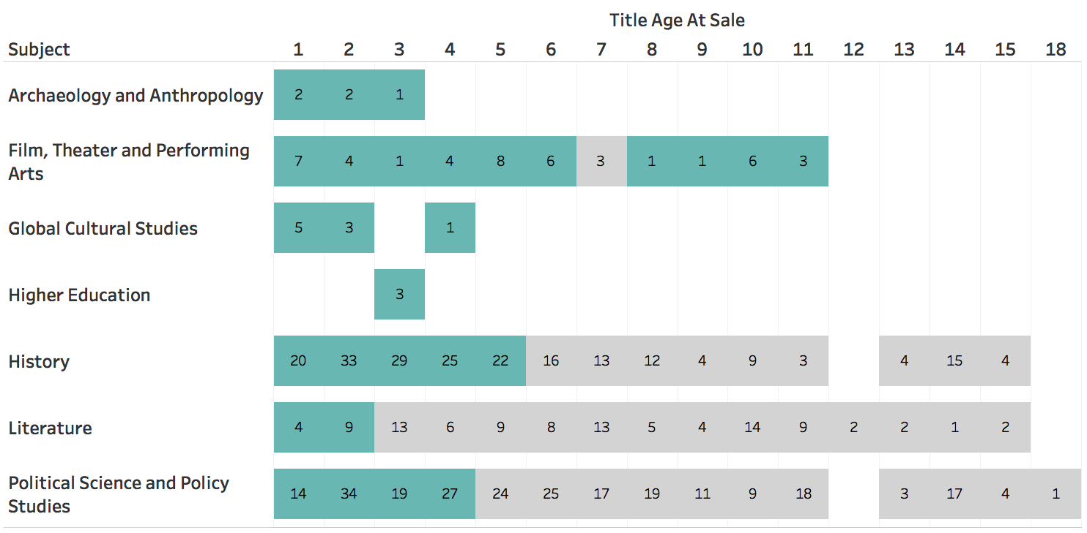
Predictive Model Results

Slide 20
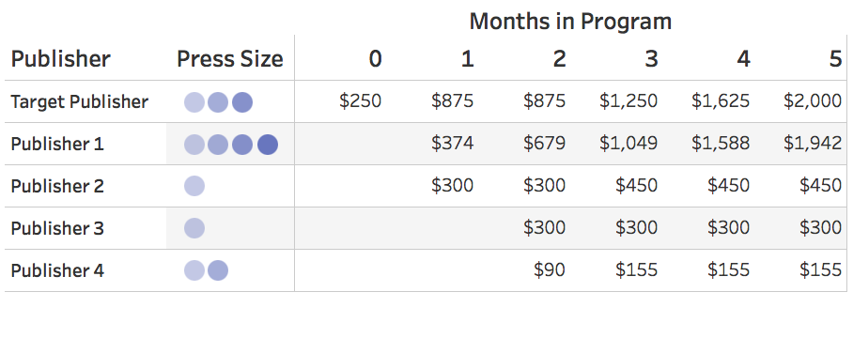
Prediction Performance Gross Sales (Running Total)

Slide 21
MUSEOPEN – July 2018
The Currency of Analytics
Creating a sustainable hosting model for OA monographs
Exploring opportunities to harmonize open and gated content on MUSE
Tracking usage data along new dimensions to foster insights that inform publishing decisions

Slide 22

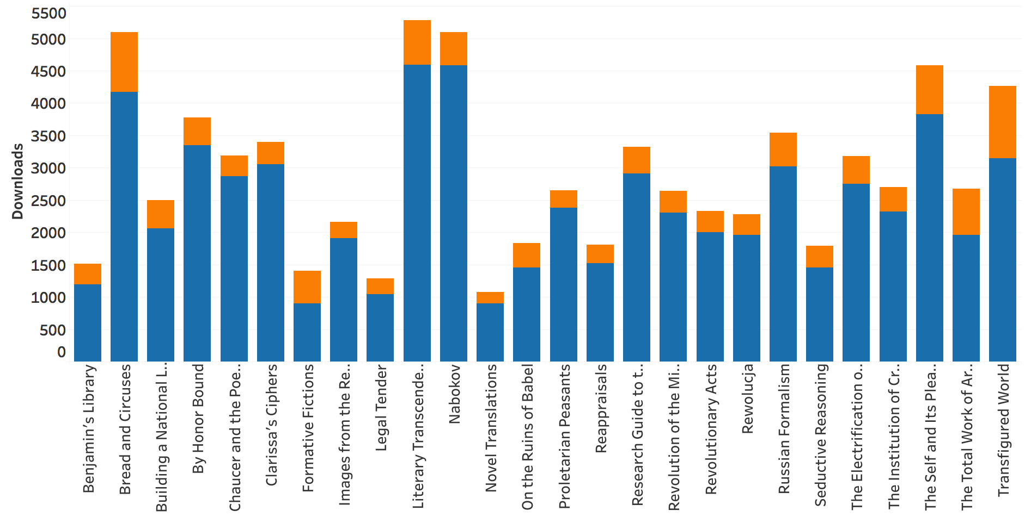
Cornell OA Usage 10/16-8/17 75,366 Downloads (84% Unknown)
muse.jhu.edu

Slide 23
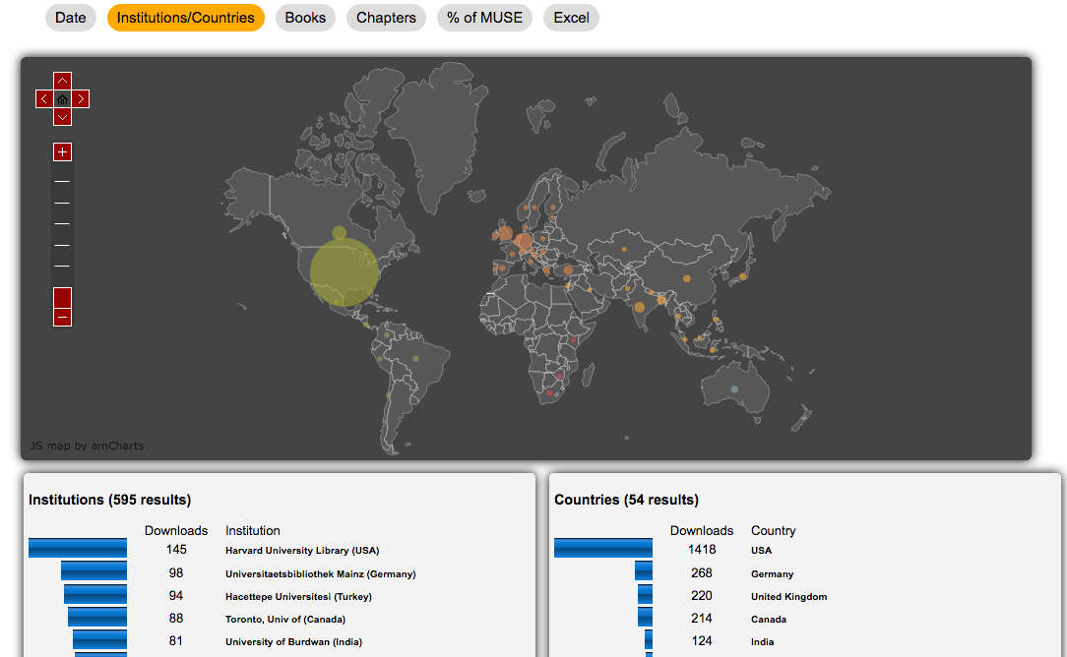
Publisher Statistics Tool

Slide 24

Publishing Services,
OER’s and
future development

Slide 25
Building Scale in University Press Publishing

Slide 26
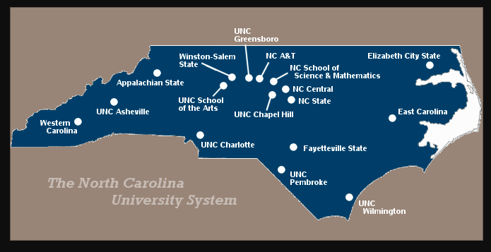
UNC System – 17 Campuses

Slide 27
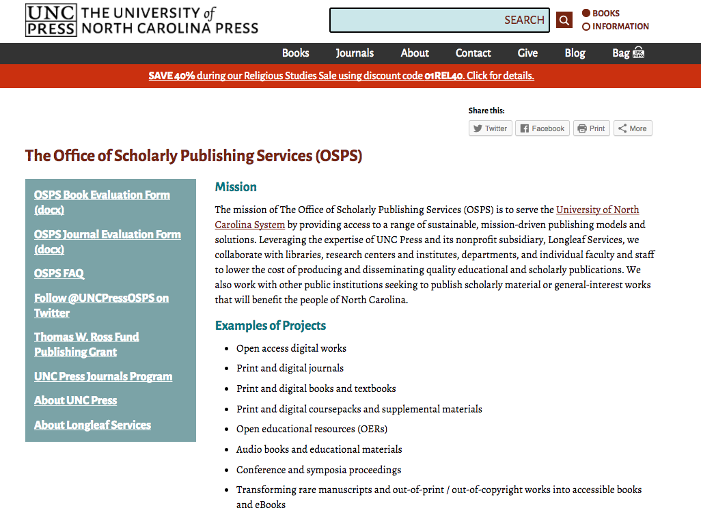

Slide 28
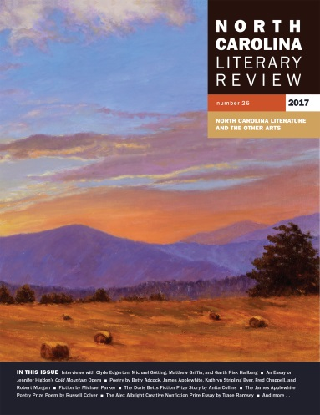









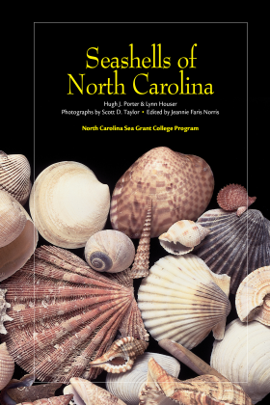
An abundance of publications

