Slide 1
A Little EBA’LL Do Ya:
How EBA is Driving Changes to eBook Purchasing

Slide 2
Participants
Nathan Turner
Senior Library Sales Executive
Cambridge University Press
nturner@cambridge.org
Anna Sansome
E-Resources Librarian (Development)
University College London Library Services
a.sansome@ucl.ac.uk
Apryl Price
Head of Acquisitions and Development
University of North Florida
a.price@unf.edu
Don Gallagher
Senior Library Sales Representative
Cambridge University Press
dgallagher@Cambridge.org

Slide 3
Can anyone share their own experiences with EBA or collaborative use-driven programs?
Any advice as to what a library or publisher can do to make these programs or collaborative efforts successful?

Slide 4
EBA in the UK
Upfront Fee
Access to content
Usage Statistics
Perpetual Access
Notes:
CUP was one of the first publishers to offer EBA when it introduced them in Scandinavia.
We began offering them for our Monographs in the UK 5 years ago.
Since then, with input from the library community we have grown the model to include all 33,000 ebooks on Cambridge Core
Flexibility is key to our EBA with the same underlying model.
Upfront Fee – We can be flexible with the upfront fee depending on a number of factors including depth and breadth of content, size of institution and length of access period.
Access to content – Librarians can choose between a wide amount of packages of content from ALL books to single subjects. Most EBA’s are for 12 months but duration can also be up to you. Timing can also be decided by the library, for example starting the 12 months from the beginning of the academic year ensuring access is maintained throughout the year, something that cannot be guaranteed with PDA.
Usage statistics – these can be provided at any time and can be help you make an informed decision at the end of the EBA but YOU are in control so can purchase however you like.
Perpetual Access – You get to keep books to the value of the upfront fee, thus developing a collection of ebooks in perpetuity in addition to all of the access to titles during the EBA

Slide 5
EBA Shaping things at Cambridge
More direct conversation between libraries and publishers
Regular EBA Forums
Influencing the direction of publishing/digitisation
Libraries are engaging more with our platform
Increased importance of discoverability
Notes:
More direct conversation between libraries and publishers – as EBA moves eBook purchasing away from third party providers it opens up a line of communication to the community
Further to this we have held a series of EBA forums in the UK, Netherlands and more recently the US in New York. These have been a great opportunity to meet with Acquisition librarians to discuss/debate the model and changes have been made off the back of these events.
Looking at usage trends and uptake of subject based EBA’s is beginning to affect the publishing programme and views on backfile digitisation.
Increased engagement with our platform has helped justify large investments such as the move to Cambridge Core from CBO and CJO which had in turn increased usage of both eBooks and Journals. This represents better value for money for libraries and enables us to invest further in infrastructure and new content.
To get the best value from your EBA you want usage to be high. To this end we have increased our Library Marketing team to help promote your EBA investment with marketing materials/campaigns etc to support your own efforts in the library.

Slide 6
eBook MARC Records at Cambridge
LC and Dewey Classification numbers (050 and 082 fields)
LC Subject Headings (600, 610, 611, 630, 650 and 651 fields)
LC Authorized forms of authors/editors’ names (100 and 700 fields)
Also, in the records that require them:
Language and Geographical codes (041 and 043 fields)
LC Authorized forms of Series’ titles (490 and 830 fields)
Corporate or Conference entries (110 and 111 fields, 710 and 711 fields)
Title variants (130, 240 and 246 fields)
Notes:
We have also created the role of Library Data Executive (Concetta) who is an ex-cataloguer who has transformed our MARC records. We are really proud of the quality of our records and Concetta is here if you want to chat or have any questions.

Slide 7
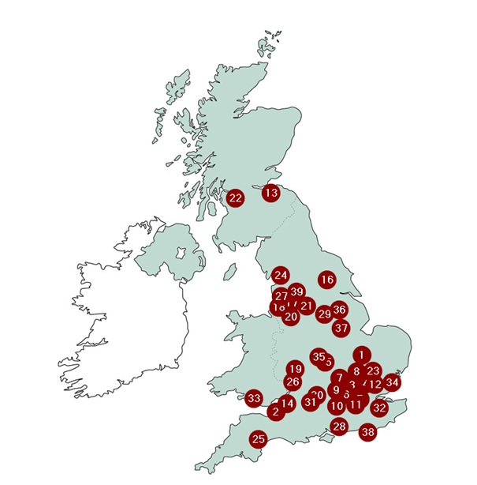
EBA’s in the UK – Fast Facts
25% of institutions have tried one
Larger collections most common
Multiple years are popular
“Year end spend” ideal time
Often driven by NSS Scores
Notes:
Just some quick facts about our experience with EBA in the UK
25% of institutions have tried one. Interestingly it wasn’t the Russell Group first!
Larger collections offer the most “Bang for your Buck!” but smaller collections are also popular either to “dip your toe into the water” or to resource a single subject. Law is most popular. Royal College of Music example.
Multiple years – Libraries are surprised that there is not diminishing returns. Institutions that take EBA’s for multiple years see good results. One UK Institution is on their 5th year. Anna I believe is a youngster at 3!
Year end spend – it enables a quick turnaround of invoicing but doesn’t rush the choice of what you are actually buying. Also a good time to start to ensure full academic year is covered.
Often driven by NSS – Explain National Student Survey…

Slide 8
Reasons for choosing EBA
To find out whether our users actually do want e-books
To give users access to a “critical mass” of content
To be more agile in giving users what they want
To ensure spend on e-books is targeted towards what people actually want
To involve users directly in the selection of content
To try to meet known and unknown unknowns

Slide 9
The results from our CUP EBA……
Year 1 (09/2015-08/2016)
21,000+ e-books available by 08/2016
197,538 section requests
11,212 e-books used at least once
479 titles purchased
Year 2 (09/2016-08/2017)
21,500+ e-books available by 08/2017
297,410 section requests
12,321 e-books used at least once
Of the e-books purchased in Y1, 454 used at least once in Y2, 56,048 section requests

Slide 10
Surprising (and not so surprising….)
High-use titles aren’t necessarily associated with the biggest courses
High-use titles aren’t necessarily in our reading list system
Titles that Subject Librarians had been asked to buy / are on reading lists didn’t necessarily get used
Users didn’t read the memo about which publishers we picked for which subjects
“X subject doesn’t want e-books” didn’t necessarily hold true
Users love it and it’s opened up some additional conversations

Slide 11
Challenges and looking to the future
Publishers don’t put all their content on their platforms / old editions / lag between print announcement and e availability
Agile for users but still legwork behind the scenes
How do we act on what the usage data tells us about the fit of our collection, what academics are listing vs what students are reading?
How does EBA fit into the wider collection strategy?
Can we fund e-book purchasing from existing resources and how do we make the case for more money?

Slide 12
Why try EBA?
Premium content
Usually unlimited simultaneous use
Little to no DRM
Usage review prior to purchase
Budget control
Little maintenance

Slide 13
Challenges
Usually limited to one publishers content
Number of titles may be limited due to budget
Balanced collection
Recurring funding

Slide 14
Moving forward
Assess the program
Implement/continue other selection methods to ensure a balanced collection
Work with vendors to improve upon the EBA plans

Slide 15
EBA Process
EBA Checklist
EBA Proposal
EBA License Agreement
EBA Invoice
EBA Initial Set Up
EBA Monthly Updates

Slide 16
Who Has EBA?
Initial EBA in US September 2014
Currently 14 in US and 3 in Canada
2017 Has Seen 7 New EBA’s Including 4 in August and 2 Starting in September
FTE’s Range from 65,000 to 3,500
One Law School and One Department of Energy Laboratory

Slide 17
Thank You!
Nathan Turner
Senior Library Sales Executive
Cambridge University Press
nturner@cambridge.org
Anna Sansome
E-Resources Librarian (Development)
University College London Library Services
a.sansome@ucl.ac.uk
Apryl Price
Head of Acquisitions and Development
University of North Florida
a.price@unf.edu
Don Gallagher
Senior Library Sales Representative
Cambridge University Press
dgallagher@Cambridge.org

