Slide 1
COUNTER 5
Caroline Kerbyson
Rachael Kendall

Slide 2
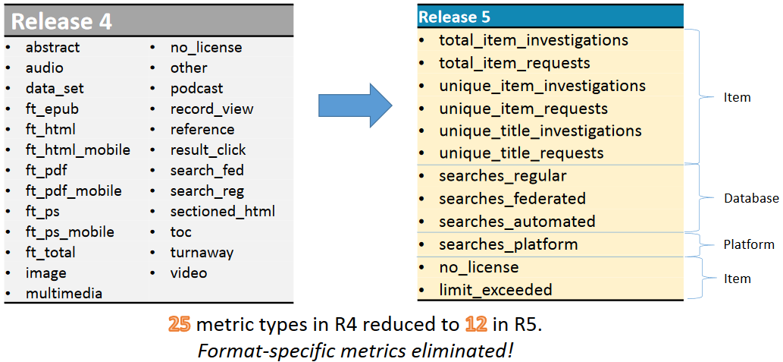
Metric Types
Graphic from https://www.projectcounter.org/

Slide 3
Mapping from COUNTER 4
Notes:
Put the presentation somewhere and also the recording of the session

Slide 4
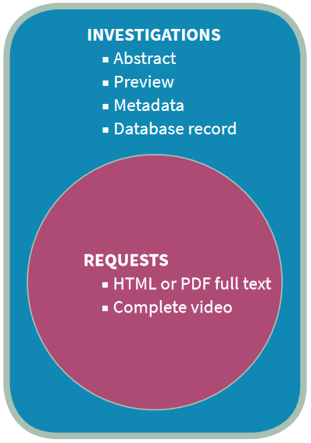
Metric Types
Investigations and Requests are the two Metric Types which show user actions
Graphic from https://www.projectcounter.org/ “THE FRIENDLY GUIDE TO RELEASE 5”, created by Tasha Mellins-Cohen who is a member of the COUNTER Executive Committee
Notes:
If someone watches part of a video is that included in an investigation?

Slide 5
Metric Types
Investigations
Total_Item_Investigations: the total number of times a content item or information related to a content item was investigated by a user
Unique_Item_Investigations: the number of unique content items (for example, chapters) investigated by a user
Unique_Title_Investigations: the number of unique titles (for example, books) investigated by a user
Graphic from https://www.projectcounter.org/ “THE FRIENDLY GUIDE TO RELEASE 5”, created by Tasha Mellins-Cohen who is a member of the COUNTER Executive Committee

Slide 6
Metric Types
Requests
Total_Item_Requests: The total number of times the full text of a content item was downloaded or viewed.
Unique_Item_Requests: The number of unique content items (for example, chapters) requested by a user
Unique_Title_Requests: The number of unique titles (for example, books) requested by a user
Graphic from https://www.projectcounter.org/ “THE FRIENDLY GUIDE TO RELEASE 5”, created by Tasha Mellins-Cohen who is a member of the COUNTER Executive Committee

Slide 7
COUNTER 4 vs COUNTER 5
Several of the COUNTER 5 reports don’t include Gold OA usage
Partial month usage no longer available
Two new access method introduced: Usage generated by text and data mining can be split out from regular user usage
There are no consortia reports – expectation is that librarians harvest multiple reports via SUSHI
Book reports include book and chapter level usage in a single report
Notes:
I’ll highlight which ones these are and it does say in the header

Slide 8
SUSHI
The same reports are available via SUSHI interface. This is an API based interface allowing automatic harvesting of reports.
RESTful API rather than SOAP XML based
Report is returned in JSON format

Slide 9
TR: Title Master Report
Books and Journals Together
Can choose to include following filters: Access Method (Regular, TDM), Data Type (book/journal), Metric Type (investigations/ requests), Access Type (controlled/OA), Section Type (book, chapter, article)

Slide 10
TR B1 – Book requests
Excludes OA Gold
Item requests only
No TDM numbers

Slide 11
TR B2 Book Access Denied (Turnaways)
Counts metric type “No license”
No need to pivot the data

Slide 12
TR B3 – Book Usage by Access Type
Broken down by metric type Item Investigations and Item Requests for each book
Includes Unique item investigations/requests and total item investigations/requests
Excludes Gold OA

Slide 13
TR J1 – Journal Requests (excl. OA Gold)
Broken out by total Item Requests and Unique Item Requests
Excludes all gold OA usage even if that’s Gold articles in Hybrid Journals

Slide 14
TR J2 – Journal Access Denied
Shows attempts to access a journal article when no license to that article has been purchased

Slide 15
TR J3 – Journal Usage by Access Type
Unique and Total Item Investigations and Requests for journals articles
Includes Gold OA

Slide 16
TR J4 – Journal Requests by YOP
Journals usage by year of publication (YOP)
Excludes Gold OA

Slide 17
Questions?
Caroline Kerbyson (Rest of World)
ckerbyson@cambridge.org
Gifty Abraham (Americas)
gabraham@cambridge.org
Training Inquiries
academictraining@cambridge.org

