Slide 1
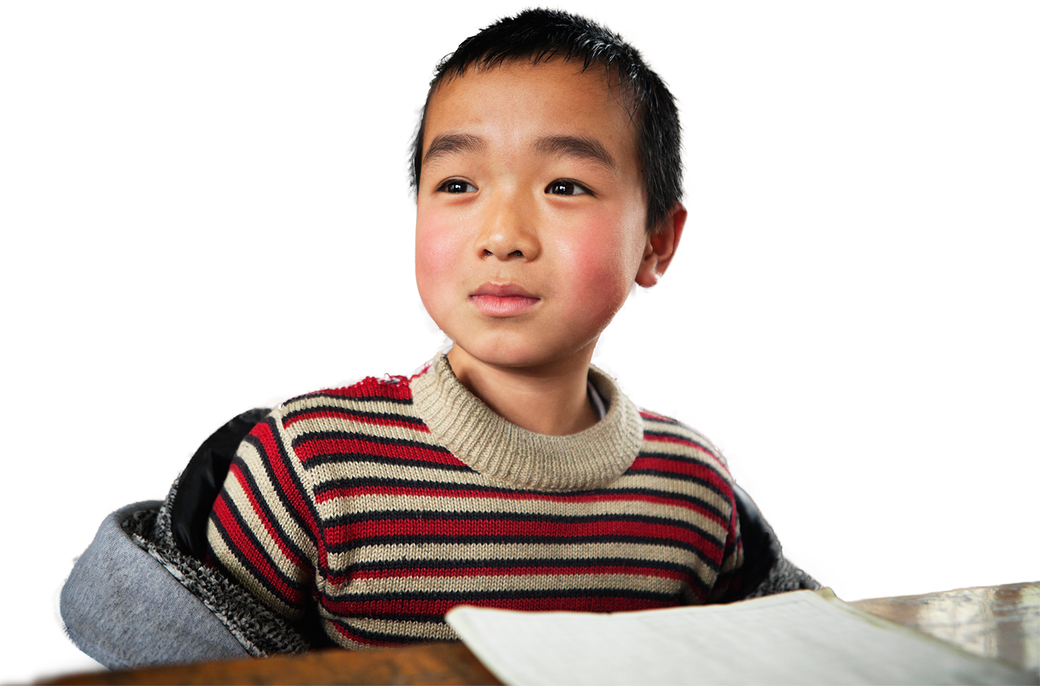
We are learning to…
say who
we play
with
talk about
sports
think about
today’s
lesson games
talk about
places to
play
things we
like and
don’t like
use
sports
words

Slide 2
describe our
favourite sports
describe our
other favourite actvities
We are
learning to…
talk about
favourite sports
and other
activities
use new sports and free-time activities words
think about
games in our lesson
we enjoyed or didn’t enjoy

Slide 3
We are learning to…
sing a fun song about a sports club in groups
write a new song verse for our sports club
share the lyrics with the other groups, then they sing it
think about how we can use songs to help us learn English

