Slide 1
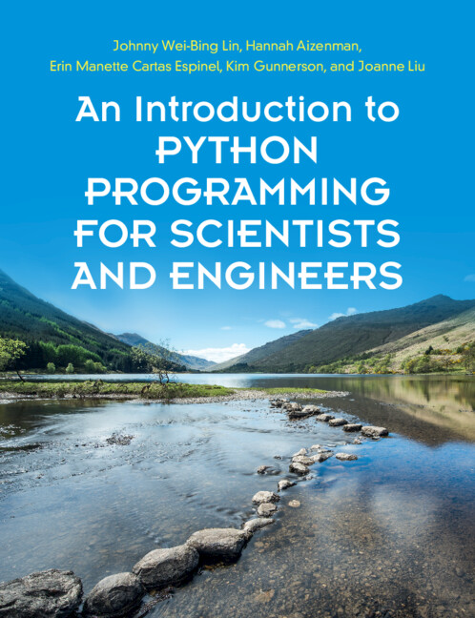
[Core Text]: [COURSE NUMBER]: [COURSE NAME]
Insert book cover
An Introduction to Python Programming for Scientists and Engineers
1st Edition
By Johnny Wei-Bing Lin, University of Washington, Bothell
Hannah Aizenman, City College, City University of New York
Erin Manette Cartas Espinel, Envestnet Tamarac, Washington
Kim Gunnerson, University of Washington, Bothell
Joanne Liu, Biota Technology Inc., California
Available from [College Bookstore] or www.cambridge.org/highereducation/isbn/9781108701129

Slide 2
Python is one of the most popular programming languages, widely used for data analysis and modelling, and is fast becoming the leading choice for scientists and engineers. Unlike other textbooks introducing Python, typically organised by language syntax, this book uses many examples from across Biology, Chemistry, Physics, Earth science, and Engineering to teach and motivate students in science and engineering. The text is organised by the tasks and workflows students undertake day-to-day, helping them see the connections between programming tools and their disciplines. The pace of study is carefully developed for complete beginners, and a spiral pedagogy is used so concepts are introduced across multiple chapters, allowing readers to engage with topics more than once. “Try This!” exercises and online Jupyter notebooks encourage students to test their new knowledge, and further develop their programming skills. Online solutions are available for instructors, alongside discipline-specific homework problems across the sciences and engineering.
What is covered by the text?

Slide 3
Features
Deviates and improves upon the traditional computer science-centric approach of teaching Python to science and engineering students
Chapters lead with practical examples from across the sciences and engineering, helping students connect programming tools with real tasks
Concepts are introduced across multiple chapters, allowing readers to engage with topics numerous times
Introduces software engineering tools and the best-practices used by professional developers in Part IV, to prepare students for writing their own high-quality code
Online digital resources include numerous Jupyter notebooks, 'Try This!' exercises, student homework problems, and solutions for course instructors

Slide 4
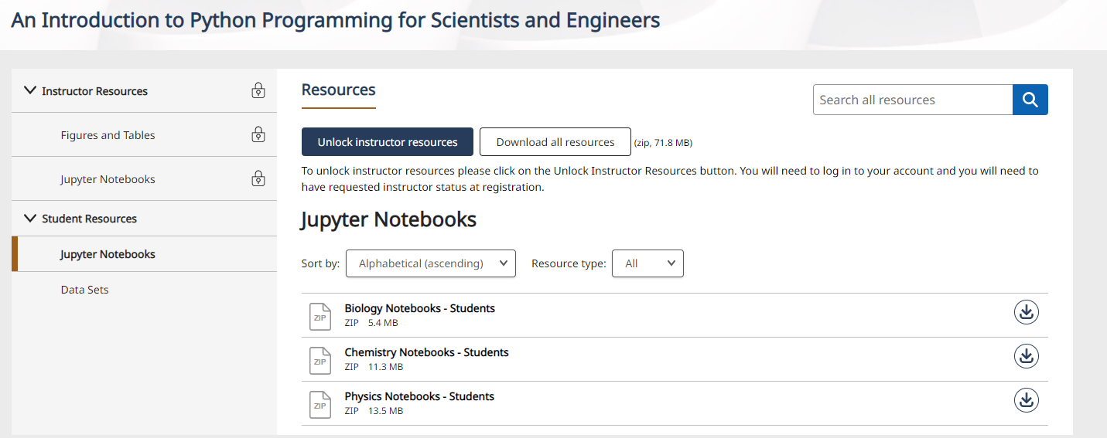
Supplementary Materials for Students
Jupyter Notebooks
Data Sets
https://www.cambridge.org/highereducation/books/an-introduction-to-python-programming-for-scientists-and-engineers/271C02A02E8B775066316E92A68E187A/resources/student-resources/17642610DE5E1CCB30DAE5FD40BDFE04
Students do not need and should not need to request access to free resources.

Slide 5
What is the Cambridge Spiral eReader?
The eReader app allows students to download the textbooks that they can access via their institution to their own offline reading bookshelf.
The eReader app allows students to highlight, bookmark and make notes within the online version of the textbook.
For students with institutional access, they will be able to read the book via their institutional login, but will need a Cambridge Higher Education account to access the full functionality
Our eTextbooks are also available for purchase by individuals who would like perpetual access

Slide 6
Accessing the Textbook Online
You will be able to access the textbook online via your institutional login or personal account.
In order to access the full functionality of Cambridge Spiral eReader, you will also need to create a Cambridge University Press Higher Education account.
To access the textbook for offline reading, please download the Cambridge Spiral eReader app.
For more access FAQs, please read here
When signing up for a HE account, you will not be automatically opted into any marketing or sales from Cambridge University Press, unless you change your preferences. Our privacy notice can be found here: www.cambridge.org/about-us/legal-notices/privacy-notice

Slide 7
What Systems does the app work on?
Download Cambridge Spiral for Higher Education from Cambridge University Press Offline Windows App
System Requirements: Windows 7+
Click here to download
Download Cambridge Spiral for Higher Education from Cambridge University Press Offline Desktop App (Apple Mac)
System Requirements: Mac OS 10.12 Sierra and above.
Click here to download
Download Cambridge Spiral for Higher Education from Cambridge University Press iOS App (iPhone/iPad)
System Requirements: iOS 10.0 and above. Download the app from the Apple Store
Cambridge Spiral for Higher Education from Cambridge University Press Android App
System Requirements: Android version 8.0 and above. Download the app from Google Play

